Slide 1
Normalization and Denormalization
Kothiya Jenil – 92500584026
Avesh Kadari – 92500584027
Nevil Aghera - 92500584012

Slide 2

Normalization
Definition:
Normalization is the process of organizing data in a database to reduce redundancy and improve data integrity.
Key Points:
Breaks large tables into smaller related tables
Removes duplicate data
Avoids anomalies (Insert, Update, Delete)

Slide 3
Normalization (Example)
1
2
3
1NF
2NF
3NF
No repeating groups (atomic values)
1NF + no partial dependency
2NF + no transitive dependency
Example:
Before:
After:
(StudentID, StudentName, Course1, Course2)
Students(StudentID, Name)
Courses(CourseID, Name)
Enrollments(StudentID, CourseID)

Slide 4

Advantages & Disadvantages Normalization
Normalization Advantages
Normalization Disadvantages
✅ Removes redundancy
❌ More joins → slower queries
✅ Ensures consistency & integrity
❌ Complex queries
✅ Saves storage space

Slide 5
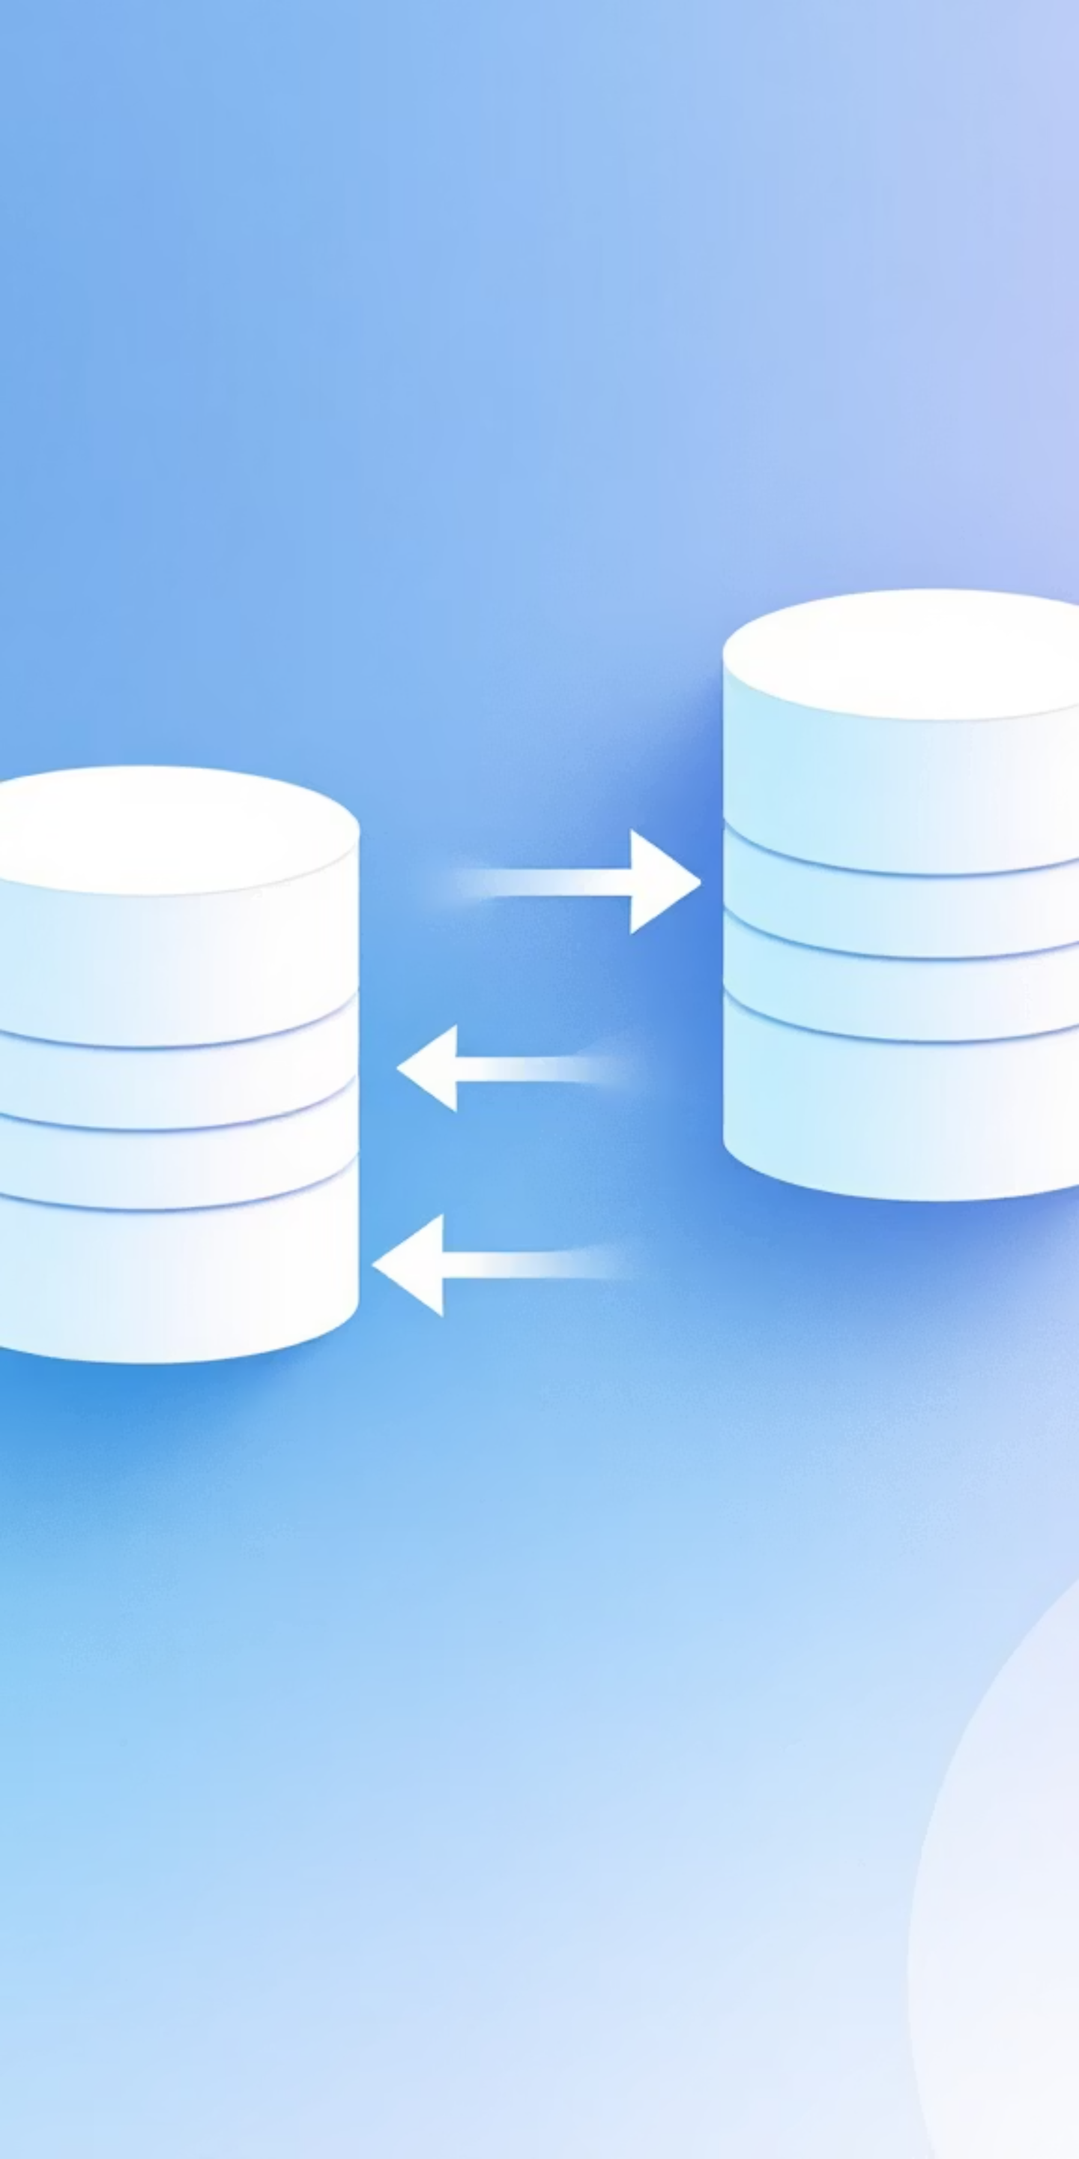
Denormalization
Definition:
Denormalization is the process of combining normalized tables and adding redundancy to improve query performance.
Reduces joins → faster queries
Common in reporting & analytics systems
Focuses on performance rather than storage

Slide 6
Denormalization (Example)
Normalized:
Denormalized:
Orders(OrderID, CustomerID, OrderDate)
Orders(OrderID, CustomerName, Address, OrderDate)
Customers(CustomerID, Name, Address)

Slide 7
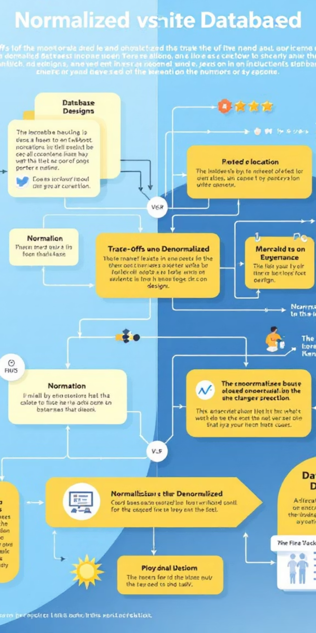
Advantages & Disadvantages
Denormalization
Denormalization Advantages
Denormalization Disadvantages
✅ Faster queries
❌ Data redundancy
✅ Simple reporting & analytics
❌ Higher risk of inconsistency

Slide 8
When to use Normalization
When you want clean and organized data
When you need to remove duplicate data
When data accuracy and integrity are very important
When you are working with transactional systems (e.g., banking, college databases, hospital systems)
When storage space matters

Slide 9
When to use Denormalization
When you need fast query results
When you want simple reports without using many joins
When performance is more important than storage
When working with data warehouses / reporting systems / analytics
When the database is used more for reading than writing

Slide 10
Thank You

